Slide 1

Twitter Sentiment Analysis
By- Anik Dutta Subhadeep Das Susmita Goswami Purbasha Hatui Udayaditya Sasmal

Slide 2

Index
Introduction
Objective
Process Diagram
Exploratory Data Analysis
Model Building
Experimental Results
Conclusion and future scope

Slide 3

Introduction
Sentiment Analysis is the interpretation and classification of emotions (positive or negative) within text data using text analysis techniques.
Sentiment Analysis basics: 1) Types of analysis ? 2) Why we use “Sentiment Analysis” ?
Twitter is an area where every tweets convey opinions. But trying to obtain the overall understanding of these unstructured data is time consuming.
Here we are trying to understand the positive and negative aspect of users using Machine Learning model.

Slide 4

bjectives:
To provide a system for user, which may be helpful to analyze the information / tweets where the data are highly unstructured and either positive or negative.

Slide 5

Process Diagram:
Data Inspection
Data Cleaning & Processing
Model Building
Deployment of Project
Output

Slide 6

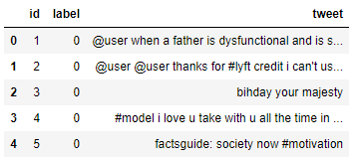

Exploratory Data Analysis(EDA): In EDA our objective is to understand the dataset and modifying them if required.
Data Inspection a) No. of columns in given dataset (3) b) No. of rows in given dataset (31962) c) Presence of nan values d) Determining the class imbalance

Slide 7

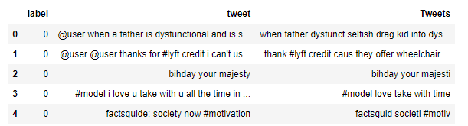
Exploratory Data Analysis(EDA):
Data Cleaning & Processing a) Removing unnecessary columns b) Removing class imbalance
c) Removing twitter handles
d) Removing special characters
e) Normalize the tweets

Slide 8

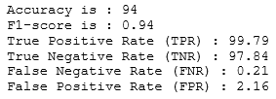
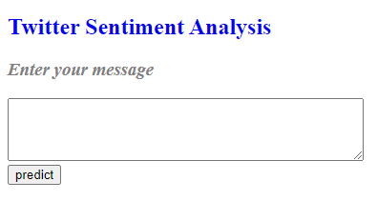
Model Building:
Using Vectorizer
Slicing dataset into train set and test set
Using Random Forest Classifier a)Why we are using this model ?
Deployment of the project a) How the model is deployed on website ?

Slide 9


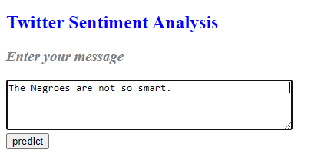
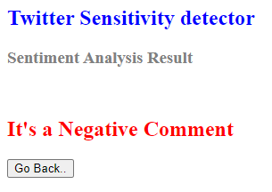
Experimental Results:
The test results are shown here based on given inputs.
Comment | Prediction | Expection
I like to watch movies. | Positive | Positive
The Negroes are not so smart. | Negative | Negative
Thank you guys. | Positive | Positive
Gender discrimination should not be eradicated. | Negative | Negative
She is so ugly. | Negative | Negative

Slide 10

Conclusion and Future Scope:
If the model can give better visualization of the content in better manner that will be helpful for the users.
The key aim is to analyze large number of tweets.
Random Forest Classifier gives us better result, but we can definitely try model ensembling.
Using parts-of-speech tagging to create new features.

Slide 11
THANK YOU

